Slide 1
FlavorForge
Azure DevSecOps Capstone
From source code → containers → Azure →
Kubernetes → secure CI/CD → GitOps → monitoring
Beginner-friendly implementation walkthrough
Notes:
Good morning everyone. Today I am presenting my FlavorForge Azure DevSecOps capstone project. I will explain the project as an implementation journey: what I created, why I created it, how I configured each technology, and how I verified that it worked. I will cover GitHub, Docker, Azure, Kubernetes, Azure DevOps, SonarCloud, Trivy, Argo CD and monitoring.

Slide 2
1. Project Introduction — What is FlavorForge?
INTRODUCTION
Frontend
Backend
Cloud-Native Delivery
React + Vite
Reusable components, pages, services
Node.js REST API
Routes, controllers, services, tests
Docker → ACR → AKS
Kubernetes + GitOps
• Recipe management application with a React frontend and Node.js backend.
• The project goal was to take a working application through a complete DevSecOps lifecycle.
• The final workflow adds automation, quality, security, scalability, GitOps and operational visibility.
FlavorForge Azure DevSecOps Capstone • 2
Notes:
FlavorForge is a full-stack recipe management application. The frontend is React and the backend is Node.js. My objective was not just to build the application. I wanted to demonstrate how the same application can move through a cloud-native DevSecOps lifecycle. That is why the repository contains application code, Docker files, Kubernetes manifests, CI/CD pipelines, security configuration, GitOps configuration and extensive verification documentation.

Slide 3
2. Problem & Objective
INTRODUCTION
Problem I wanted to solve
Objective
Manual build and deployment steps are time-consuming, error-prone and difficult to repeat consistently. Quality and security checks can also become inconsistent when they are performed manually.
Create a repeatable path from source code to a running application with automated testing, code-quality checks, security scanning, container publishing, Kubernetes deployment and GitOps.
Code
Build & Test
Quality
Security
Container
Deploy
Observe
FlavorForge Azure DevSecOps Capstone • 3
Notes:
The main problem was the gap between application development and reliable deployment. My objective was to automate and standardize that path. I wanted the project to demonstrate more than a successful application: I wanted repeatability, security checks, containerization, Kubernetes deployment and GitOps. This objective drove the technology choices that I will explain in the next slides.

Slide 4
3. Architecture / Complete DevSecOps Flow
ARCHITECTURE
Developer
GitHub
Azure DevOps
SonarCloud
Trivy
Docker
ACR
AKS
Argo CD
Monitor
CI — Build & Validate
CD / GitOps — Deploy
Operations — Verify
Source change triggers the delivery workflow.
Build → Test → SonarCloud → Trivy → Docker build → image publishing
Kubernetes configuration is stored in Git. Argo CD watches desired state and reconciles the AKS cluster.
Pods, services, health endpoints, logs, events and monitoring provide operational visibility after deployment.
FlavorForge Azure DevSecOps Capstone • 4
Notes:
This is the complete architecture and the story I will follow. GitHub is the source-code and version-control layer. Azure DevOps automates build, test, security, containerization and publishing. SonarCloud checks source-code quality and Trivy scans for known vulnerabilities. Docker creates portable images and ACR stores them. AKS runs the Kubernetes workloads. Argo CD provides GitOps-based continuous delivery, and monitoring gives operational visibility. I will now walk through how I implemented each block.

Slide 5
4. Technology Stack
ARCHITECTURE
Source control
Application
Containers
GitHub
React + Node.js
Docker + Docker Compose
Cloud
Registry
Orchestration
Microsoft Azure
Azure Container Registry
AKS + Kubernetes
Configuration
CI/CD
Quality
Kustomize
Azure DevOps
SonarCloud
Security
GitOps
Observability
Trivy
Argo CD
Azure Monitor / Kubernetes logs
FlavorForge Azure DevSecOps Capstone • 5
Notes:
These are the technologies I used and how I grouped them. I am intentionally not presenting them as isolated tools. Each one has a specific role in the delivery lifecycle. I will explain the implementation in the same order that a change moves through the system.

Slide 6
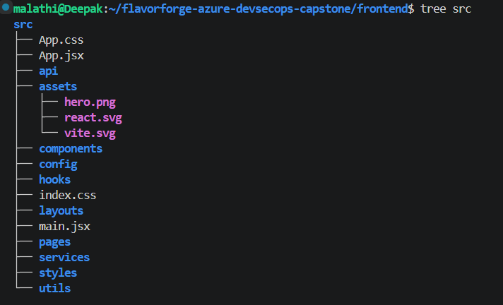
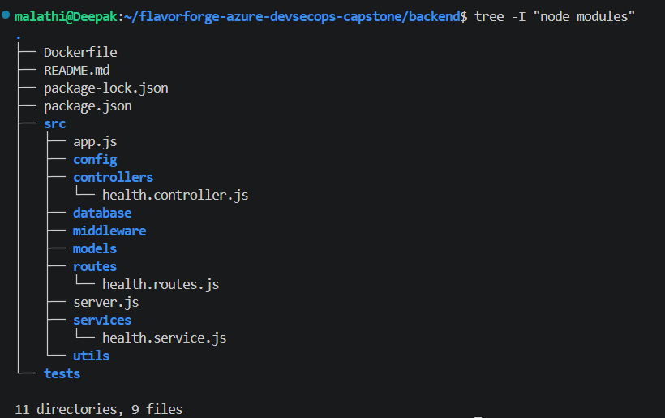
5. Application Development — Frontend + Backend
IMPLEMENTATION
Frontend — React
Backend — Node.js
Components → Pages → Layouts → API services
The frontend contains reusable components such as Header, Hero, RecipeList, SearchBar and status/error components.
Routes → Controllers → Services → Tests
The backend exposes health and recipe APIs and separates request handling from business logic.
GET /api/health
Expected result:
{"status":"ok"}
SCREENSHOT TO SHOW
screenshots/frontend/04-frontend-enterprise-structure.png
SCREENSHOT TO SHOW
screenshots/backend/05-layered-backend-architecture.png
Evidence to show: frontend structure
Evidence to show: backend structure
FlavorForge Azure DevSecOps Capstone • 6
Notes:
First I built the application itself. On the frontend I used React with reusable components, pages and a service layer for API communication. On the backend I used a layered Node.js structure with routes, controllers, services and tests. I also created a health endpoint. This is important later because Kubernetes and operational monitoring need a reliable way to check whether the backend is responding. In the live presentation I will show the frontend structure, backend structure and the health endpoint rather than walking through every source file.

Slide 7
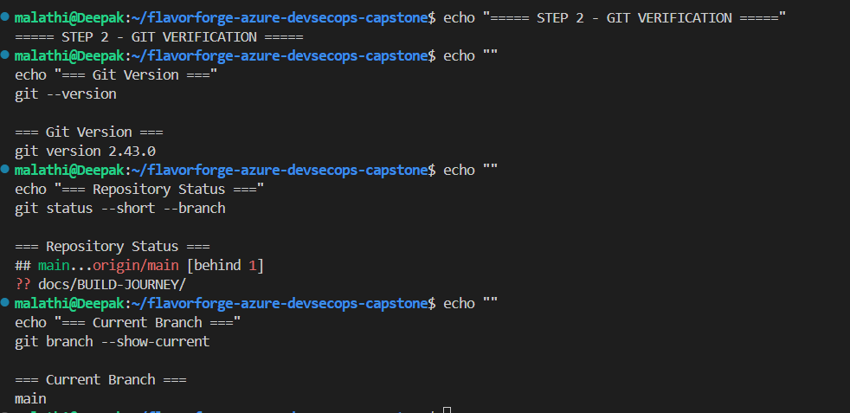
6. GitHub — Source Code Management
IMPLEMENTATION
What I created
SCREENSHOT TO SHOW
screenshots/build-journey/02-github/01-github-repository.png
git status
git remote -v
git log --oneline -3
Repository:
flavorforge-azure-devsecops-capstone
The repository contains application code, Docker, Kubernetes, pipelines, Argo CD configuration, scripts and documentation.
Show: GitHub repository
How I implemented it
Local Git repository → GitHub remote → versioned commits. I also configured Azure DevOps as another remote so the same repository history can be synchronized there.
FlavorForge Azure DevSecOps Capstone • 7
Notes:
I started by creating the GitHub repository and connecting my local project to it. Git is the version-control layer. I used commits to record changes and push to the remote repository. The important commands to remember are git status, git remote -v and git log --oneline. I also configured Azure DevOps as another remote, which is why the project can be synchronized between GitHub and Azure DevOps. I am demonstrating source-control implementation here, not just explaining what GitHub is.

Slide 8
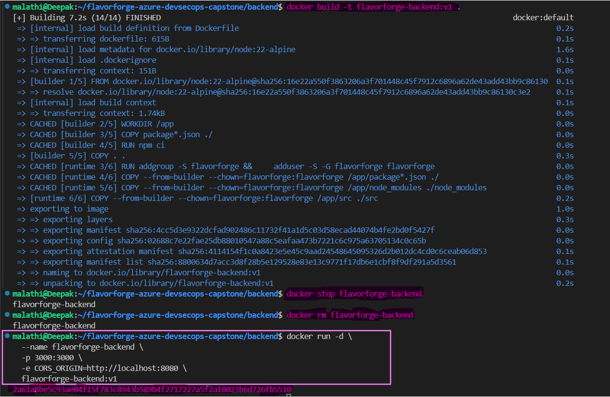
7. Docker — Containerization
IMPLEMENTATION
Why Docker?
What I created
Verification
“Works on my machine” becomes a reproducible application package.
Separate Dockerfiles for frontend and backend, plus Docker Compose for local multi-container integration.
Built images, started containers, checked processes, API health and the running website.
Source
Dockerfile
Image
Container
Verified App
docker images
docker ps
# Example flow
docker build ...
docker run ...
SCREENSHOT TO SHOW
screenshots/docker/10-frontend-backend-container-running.png
Show: frontend + backend containers running
FlavorForge Azure DevSecOps Capstone • 8
Notes:
Docker was the next step because I wanted the application to be portable and reproducible. I created separate Dockerfiles for the frontend and backend and also used Docker Compose for local integration. The implementation flow was source code to Dockerfile to image to running container. To verify it, I used docker images and docker ps and checked the running application and API. The key point is that the same image concept can later be pushed to ACR and used by Kubernetes.

Slide 9
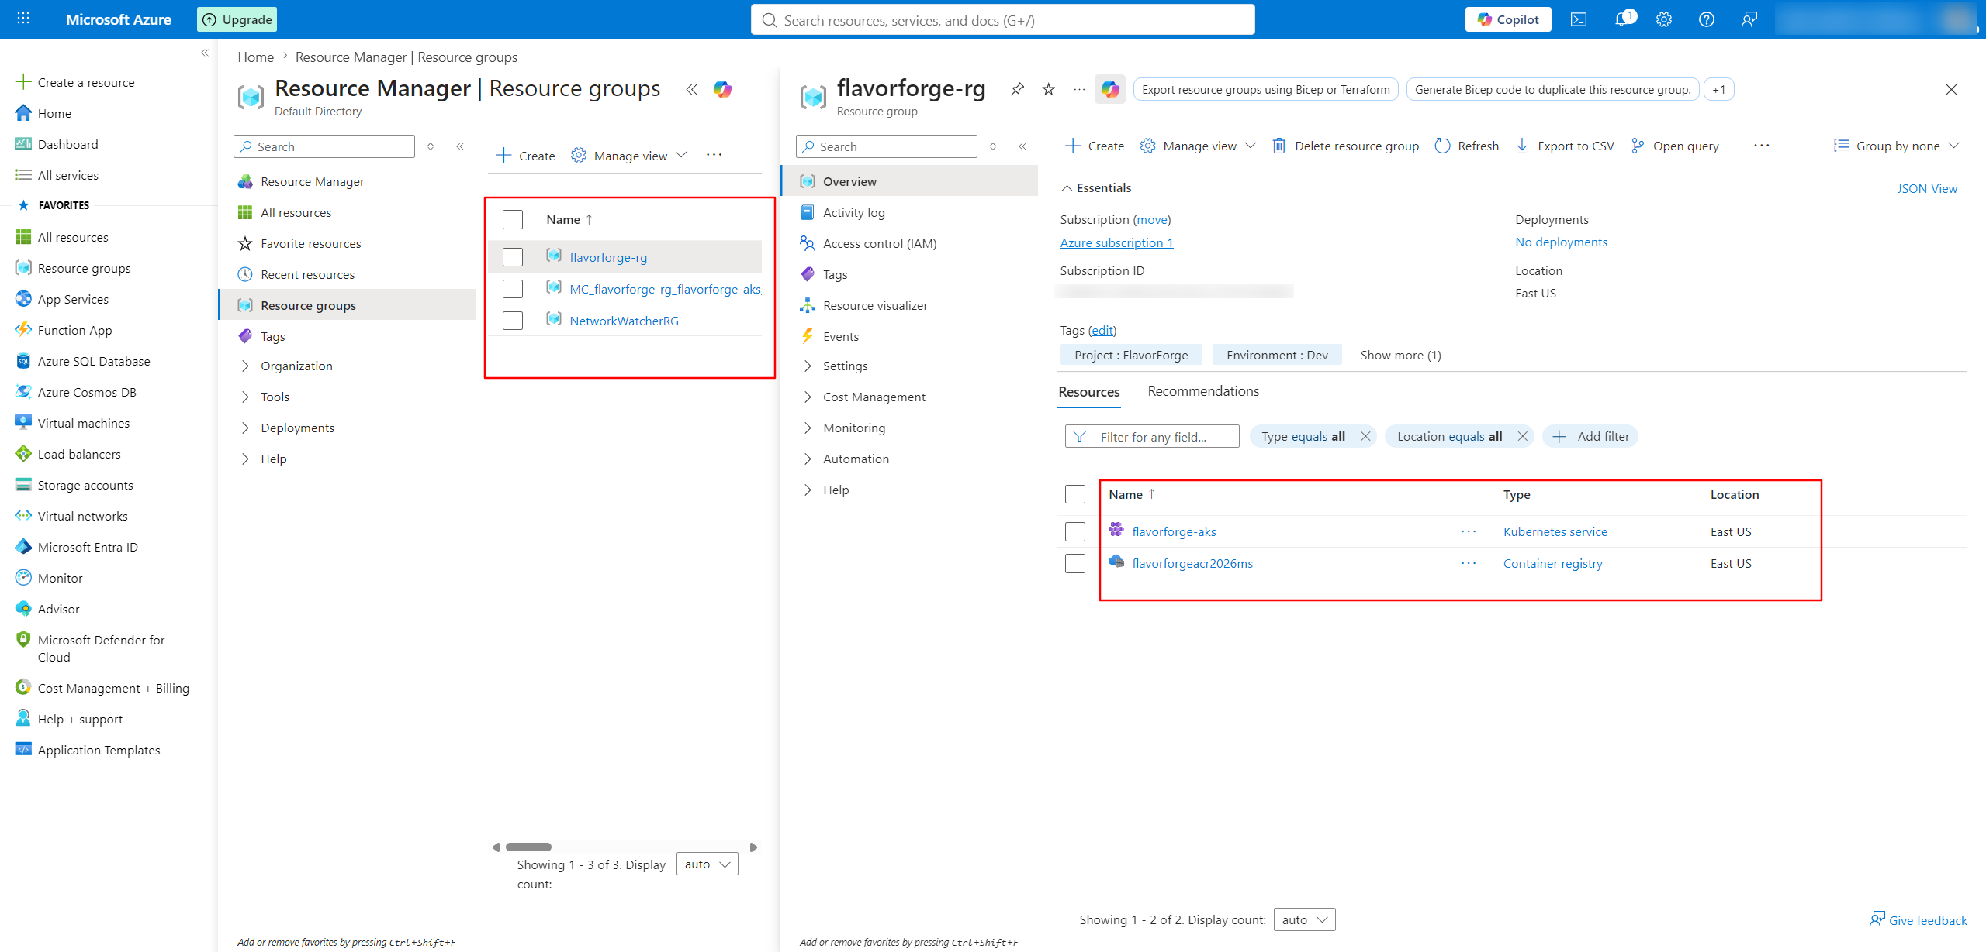
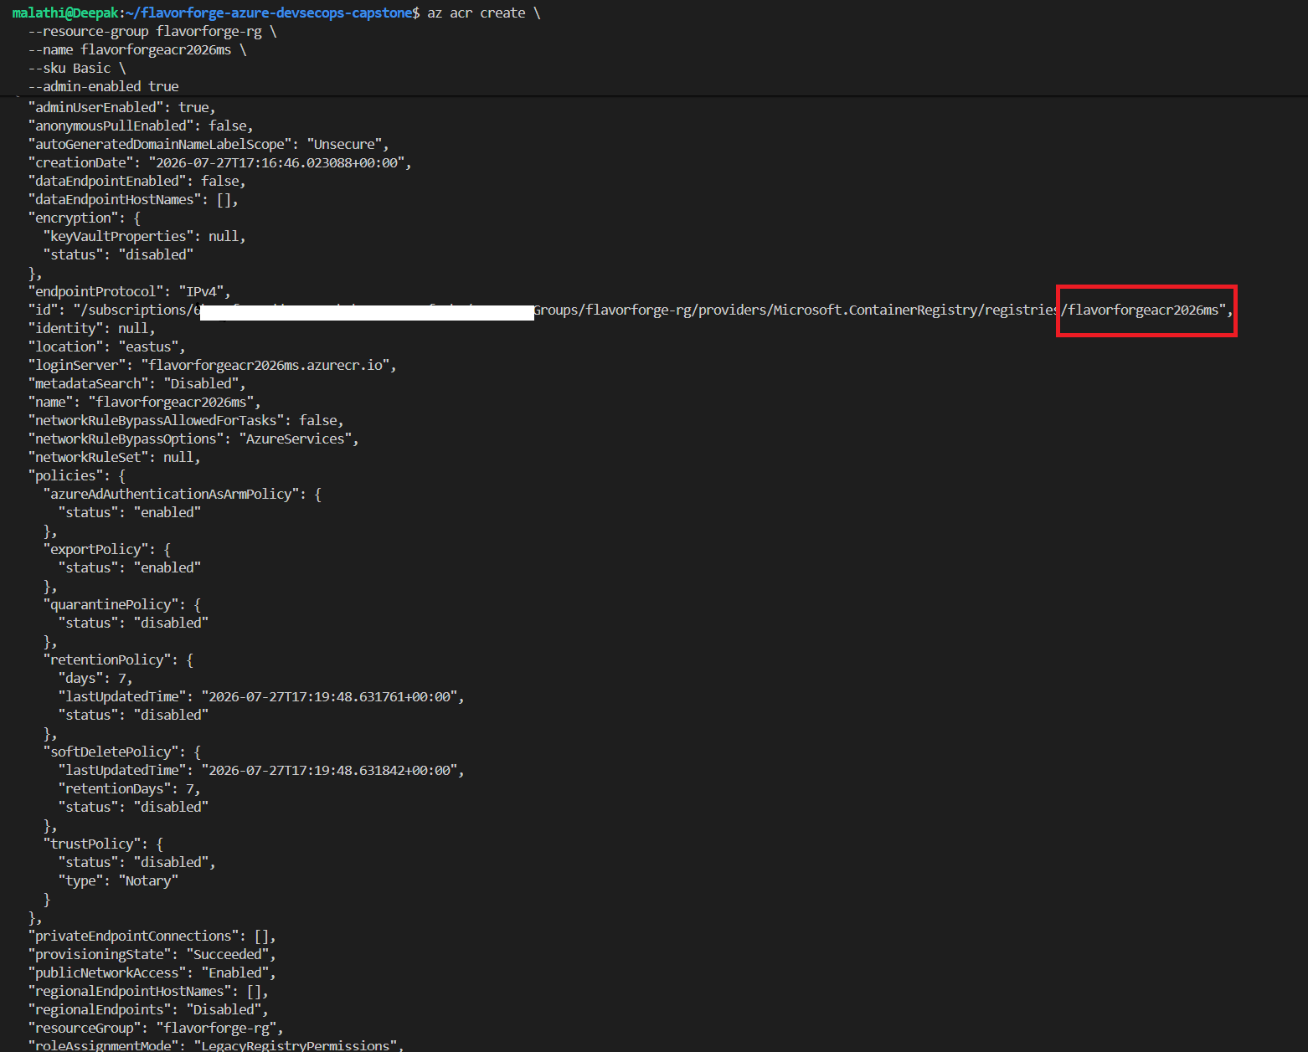
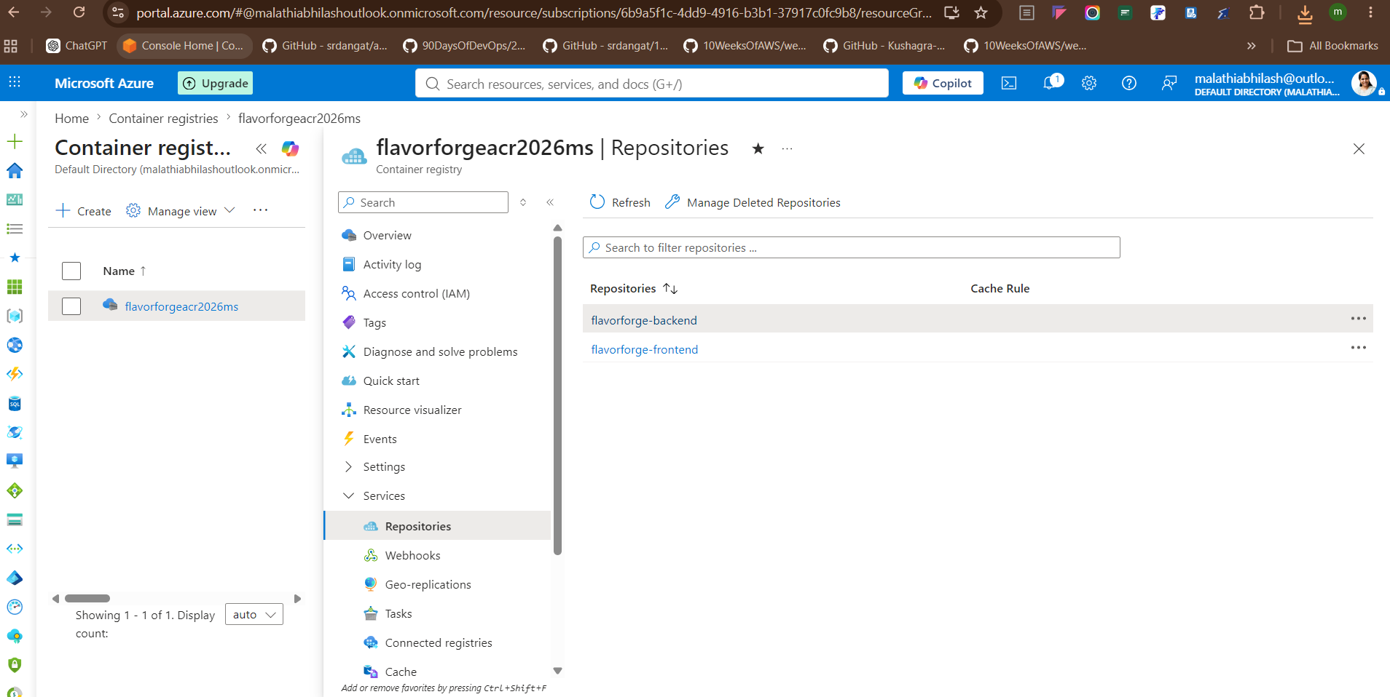
8. Azure — Resource Group + ACR
IMPLEMENTATION
Resource Group
Azure Container Registry
Why ACR?
flavorforge-rg
Logical container for the Week 4 Azure resources.
flavorforgeacr2026ms
Region: East US
SKU: Basic
Login server: flavorforgeacr2026ms.azurecr.io
Docker images need a central registry so AKS can consume versioned images from Azure.
SCREENSHOT TO SHOW
screenshots/azure/flavorforge-rg-microsoft-azure-resource-group.png
SCREENSHOT TO SHOW
screenshots/azure/04-acr-created.png
SCREENSHOT TO SHOW
screenshots/azure/25-acr-images.png
Show: Azure Resource Group
Show: ACR created
Show: images in ACR
FlavorForge Azure DevSecOps Capstone • 9
Notes:
For the Week 4 Azure environment I created the resource group flavorforge-rg. I then created the Azure Container Registry flavorforgeacr2026ms in East US using the Basic SKU. ACR is the image repository. The important distinction is that the resource group organizes Azure resources, while ACR specifically stores container images. I will show the resource group, the registry creation evidence and the images available in ACR. I am intentionally not mixing in the separate Week 3 VM lab here.

Slide 10
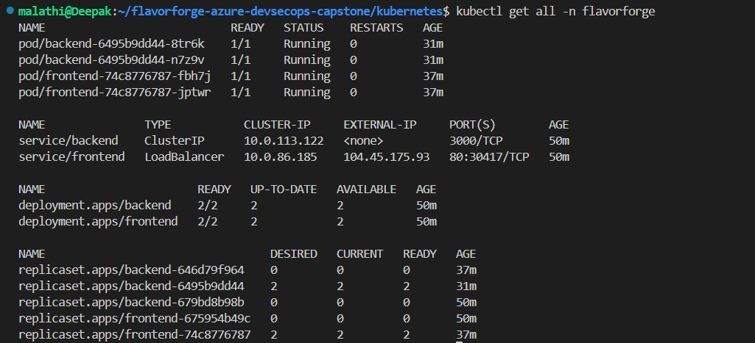
9. Kubernetes & AKS
IMPLEMENTATION
AKS
Kubernetes Objects
What Kubernetes gives me
Managed Kubernetes service.
Cluster: flavorforge-aks
Region: East US
2 nodes
Node size: Standard_D2as_v7
Namespace → Deployments → Pods
Services → Ingress → HPA
Desired state, scheduling, replica management, service discovery and rolling updates.
kubectl get nodes
kubectl get all -n flavorforge
kubectl get pods -n flavorforge
kubectl get svc -n flavorforge
kubectl get deployments -n flavorforge
SCREENSHOT TO SHOW
screenshots/kubernetes/kubectl-get-all-n-flavorforge.png
Show: running Kubernetes workloads
FlavorForge Azure DevSecOps Capstone • 10
Notes:
AKS is Microsoft's managed Kubernetes service, so I did not have to manage the Kubernetes control plane myself. My cluster is flavorforge-aks in East US with two nodes using Standard_D2as_v7. Inside the cluster I created a namespace, backend and frontend Deployments, Pods, Services, Ingress configuration and HPA. I use kubectl to inspect the state. In beginner terms: Deployments describe what should run, Pods are the actual running instances, Services provide stable networking, and HPA can change replica counts based on resource usage.

Slide 11
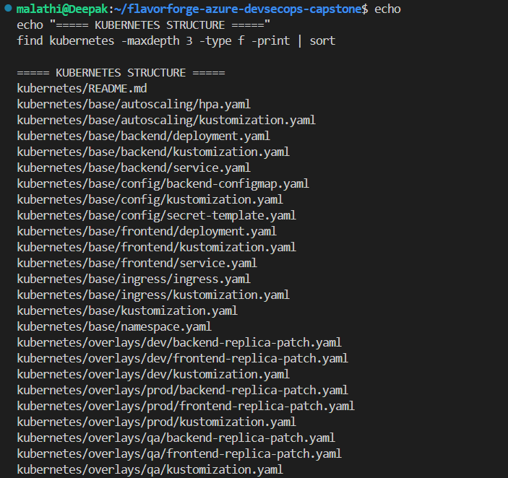
10. Kustomize — Environment Management
IMPLEMENTATION
Base configuration
Overlays
Reusable Kubernetes definitions for namespace, frontend, backend, services, config, ingress and autoscaling.
Environment-specific changes are kept under:
kubernetes/overlays/dev
kubernetes/overlays/qa
kubernetes/overlays/prod
kubectl kustomize kubernetes/overlays/dev
kubectl kustomize kubernetes/overlays/qa
kubectl kustomize kubernetes/overlays/prod
SCREENSHOT TO SHOW
screenshots/build-journey/kustomize/Kubernetes-Kustomize structure.png
Show: base + overlays structure
FlavorForge Azure DevSecOps Capstone • 11
Notes:
Kustomize solves an environment-management problem. Instead of copying the entire Kubernetes configuration three times, I created a reusable base and overlays for dev, QA and prod. The overlays change environment-specific values such as replica counts while keeping the common configuration reusable. I validated the rendered configuration using kubectl kustomize. In the presentation I will show the repository structure and one render command. I will describe these as configuration overlays, not as three separate production AKS clusters.

Slide 12
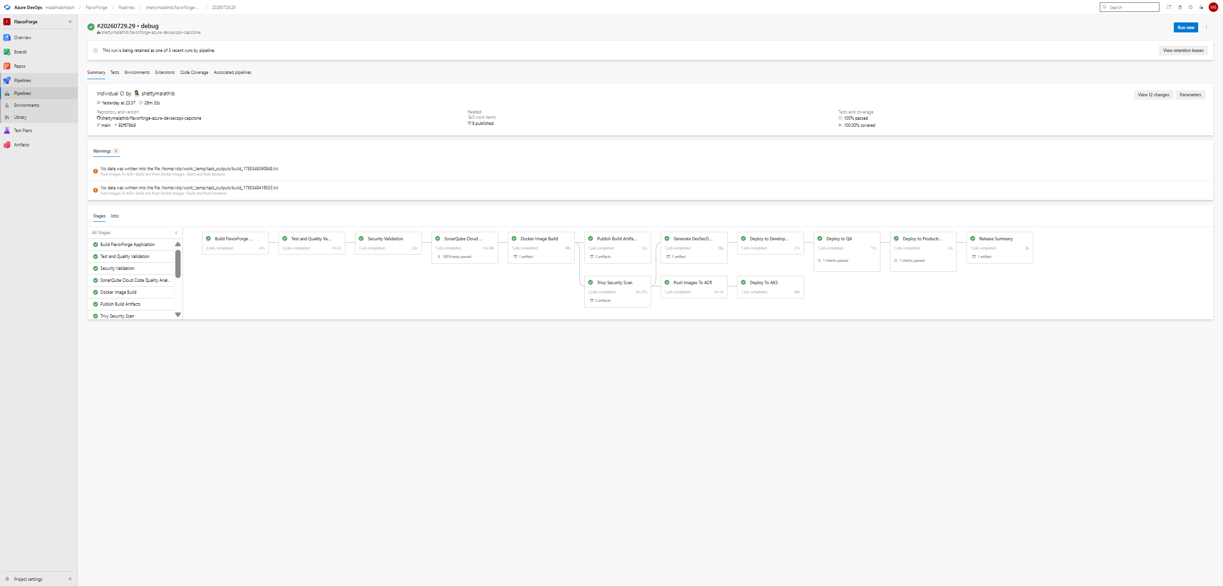
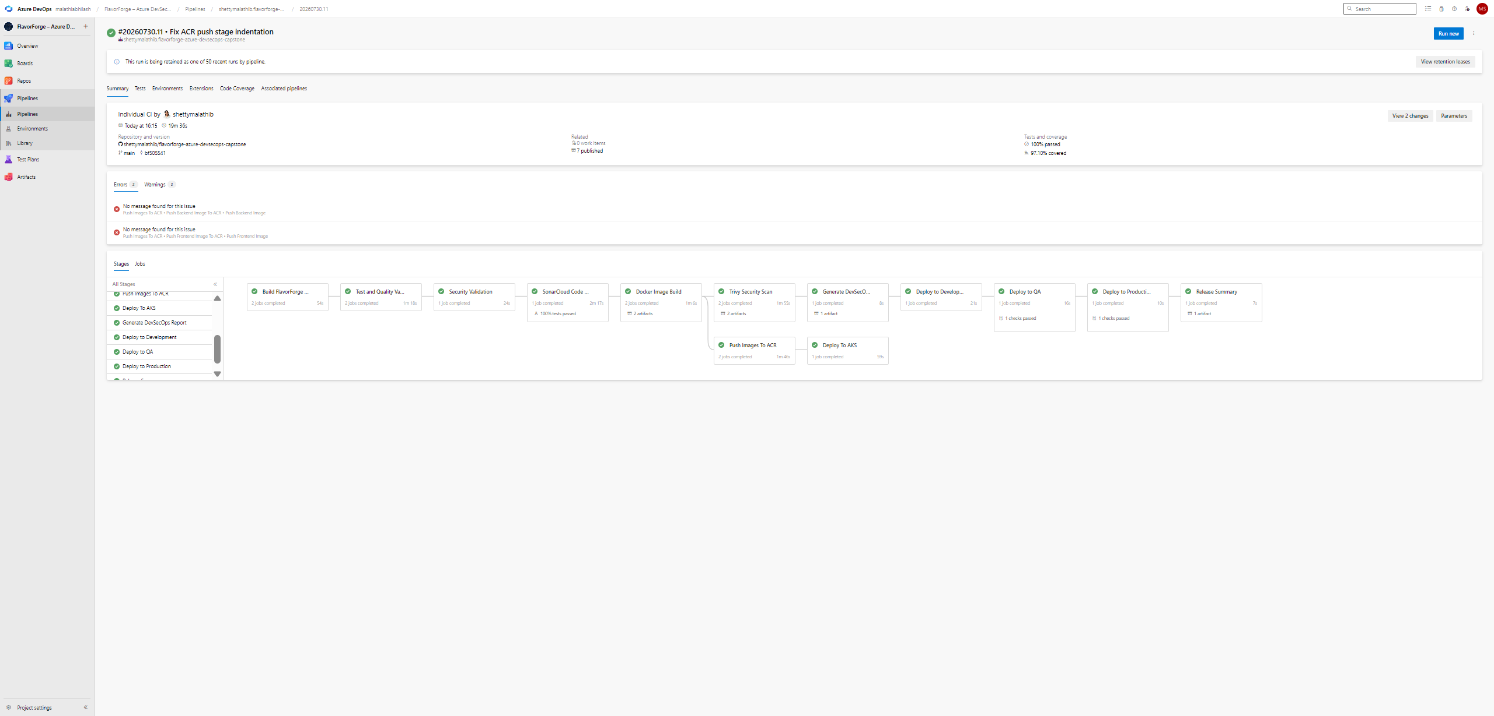
11. Azure DevOps — CI Pipeline
IMPLEMENTATION
Build
Test
Code Quality
Security
Docker Build
Trivy
Push to ACR
Deploy
SCREENSHOT TO SHOW
screenshots/pipeline/13-pipelines-run.png
SCREENSHOT TO SHOW
screenshots/enterprise-azure-devops-release-simulation/14-final-azure-pipeline.png
# azure-pipelines.yml
stages:
- Build
- Test
- Security
- CodeQuality
- DockerBuild
- TrivyScan
- Push
- Deploy
Show: Azure DevOps pipeline run
Show: pipeline stages/configuration
Beginner explanation
One source change moves through automated validation and packaging instead of repeating the same manual commands for every release.
FlavorForge Azure DevSecOps Capstone • 12
Notes:
Azure DevOps is the automation engine. I defined the workflow in azure-pipelines.yml. The stages have clear responsibilities: Build, Test, Security, CodeQuality, DockerBuild, TrivyScan, Push and Deploy. I also configured service connections for Azure resources. In the presentation I will show the pipeline definition and a successful pipeline run. The important implementation point is that the pipeline encodes the process so it can be repeated consistently.

Slide 13
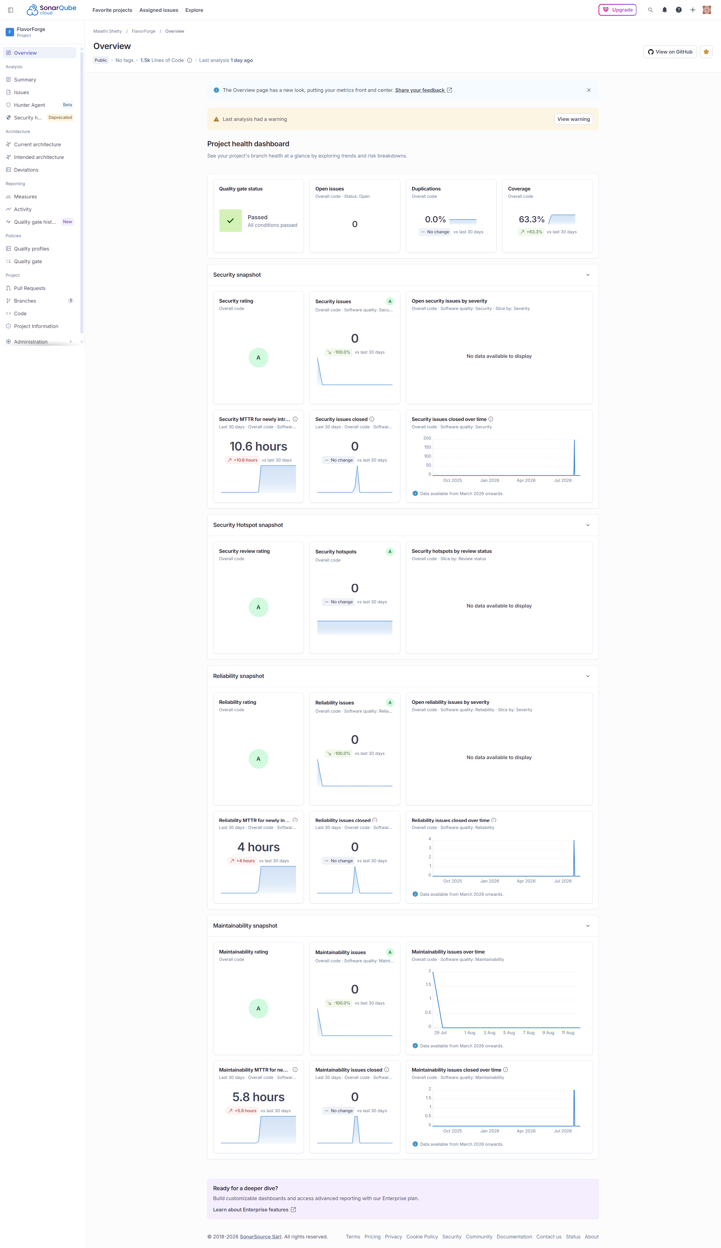
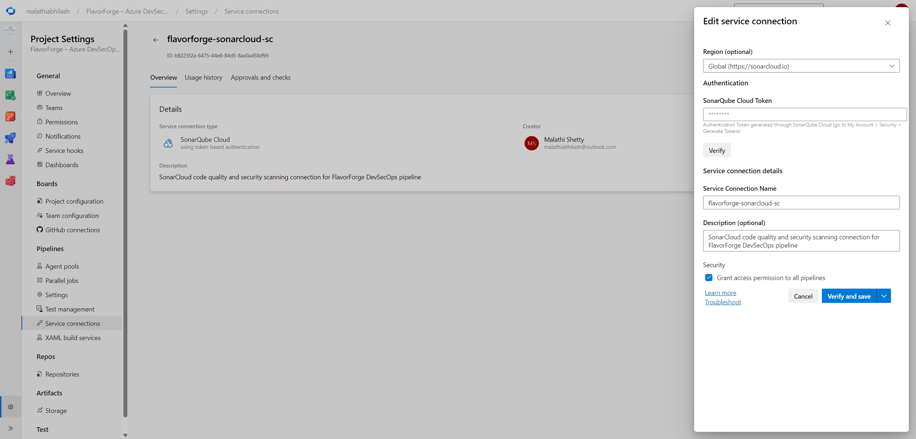
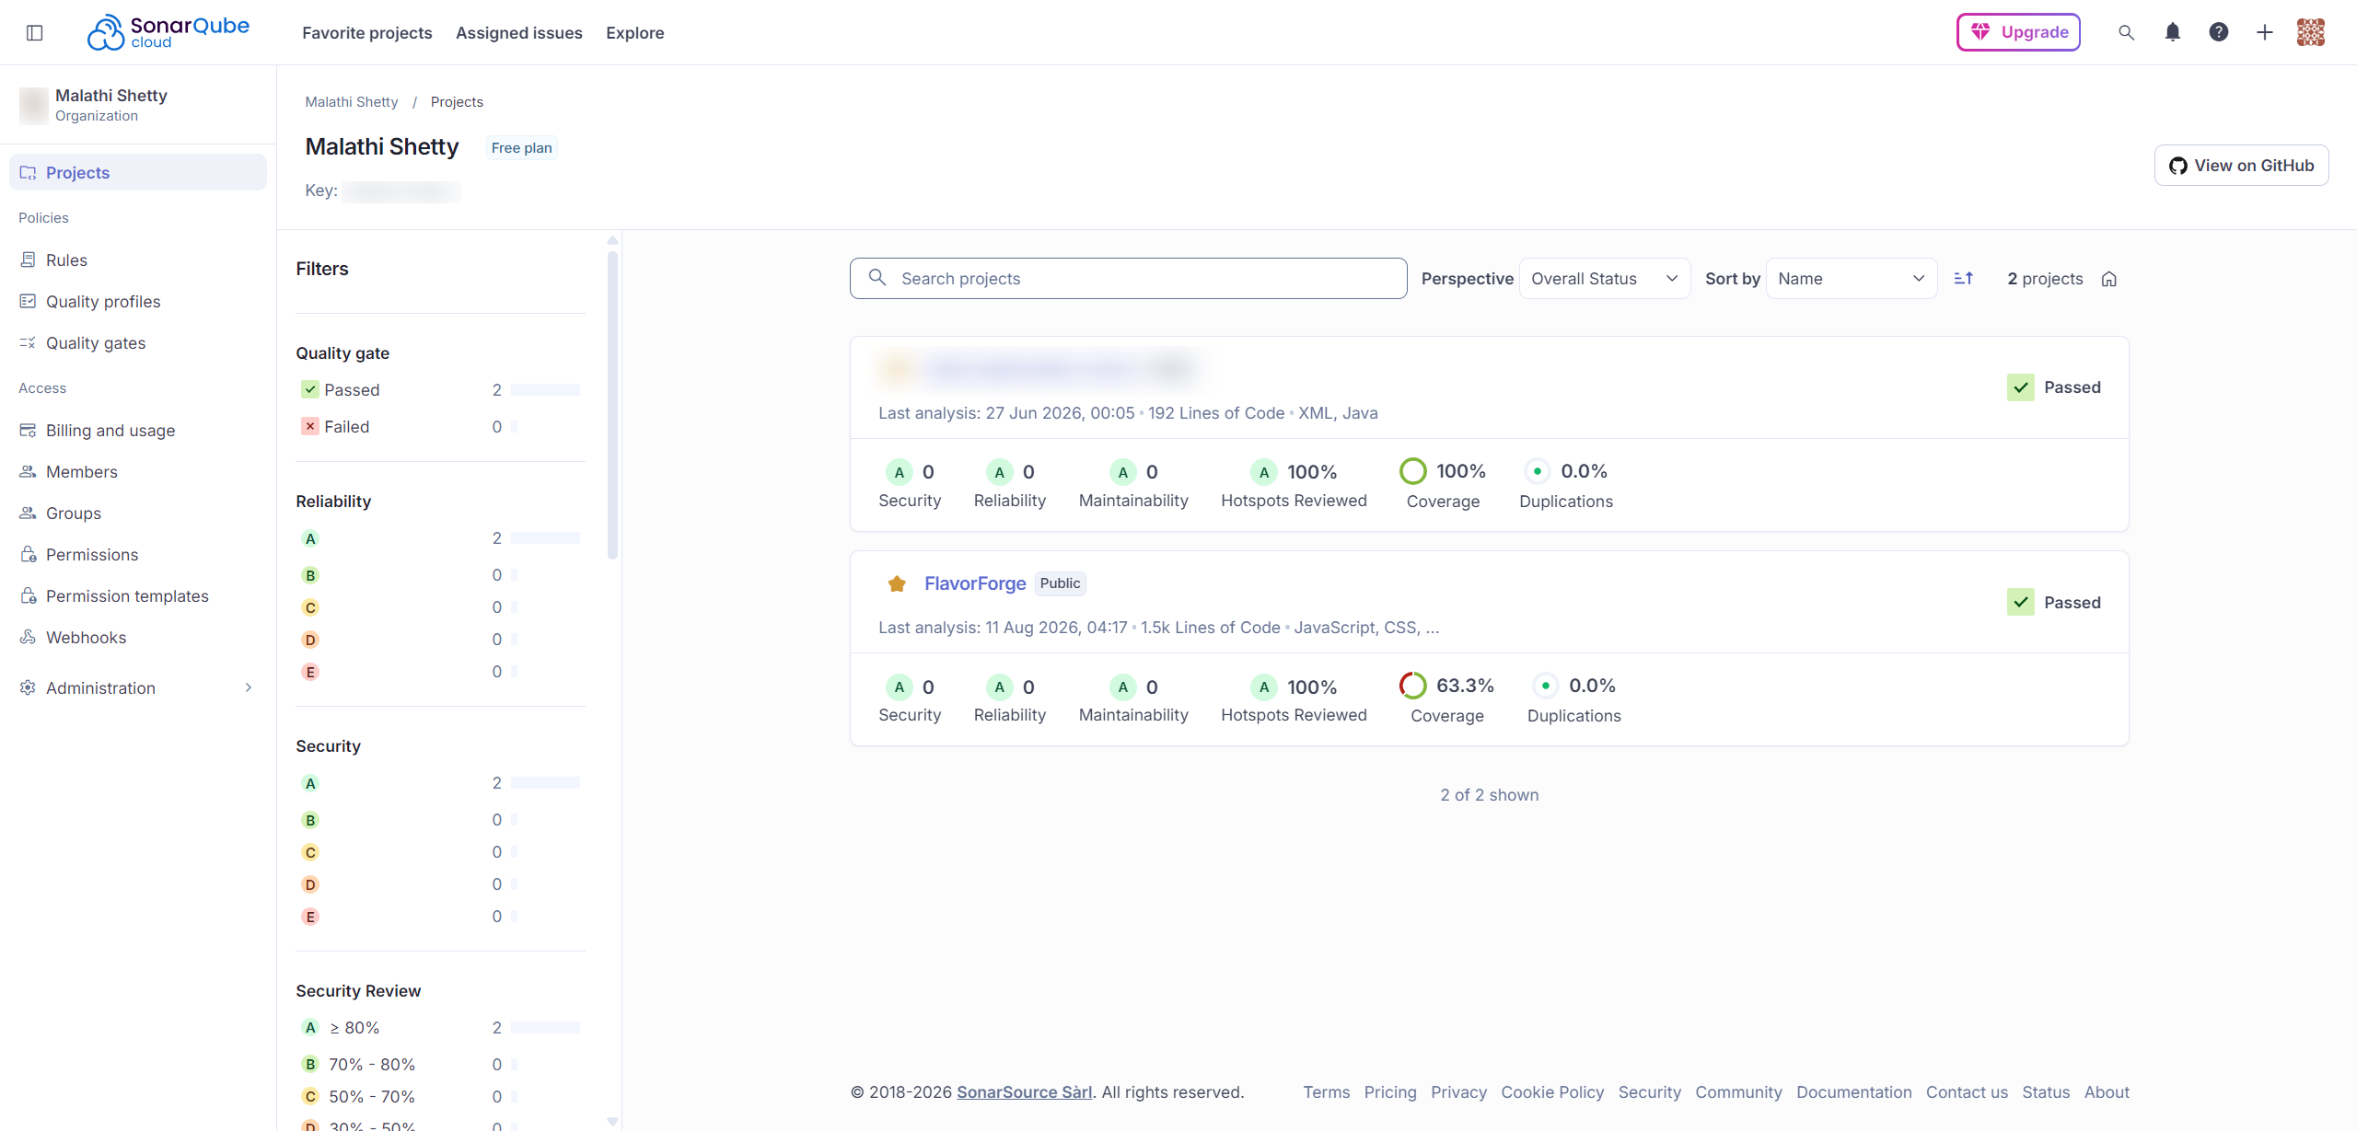
12. SonarCloud — Code Quality
SECURITY
What question does SonarCloud answer?
How I implemented it
Created the SonarCloud project, configured the Azure DevOps service connection and integrated analysis into the pipeline.
“Does my source code contain quality, reliability or maintainability problems that should be addressed before delivery?”
SCREENSHOT TO SHOW
screenshots/build-journey/sonarqube/flavorforge-project-overview.png
SCREENSHOT TO SHOW
screenshots/build-journey/sonarqube/azure-devops-sonarcloud-service-connection.png
SCREENSHOT TO SHOW
screenshots/build-journey/sonarqube/projects-sonarCloud-dashboard.png
Show: FlavorForge SonarCloud project
Show: service connection
Show: SonarCloud dashboard
FlavorForge Azure DevSecOps Capstone • 13
Notes:
SonarCloud is the code-quality control in my pipeline. I created the FlavorForge project, configured the Azure DevOps service connection and integrated analysis. The purpose is not to replace testing. It provides a separate quality view of the source code, such as bugs, vulnerabilities, code smells and maintainability concerns. I will show the project dashboard and the service connection evidence. I should explain what I configured rather than claiming SonarCloud is simply a generic testing tool.

Slide 14
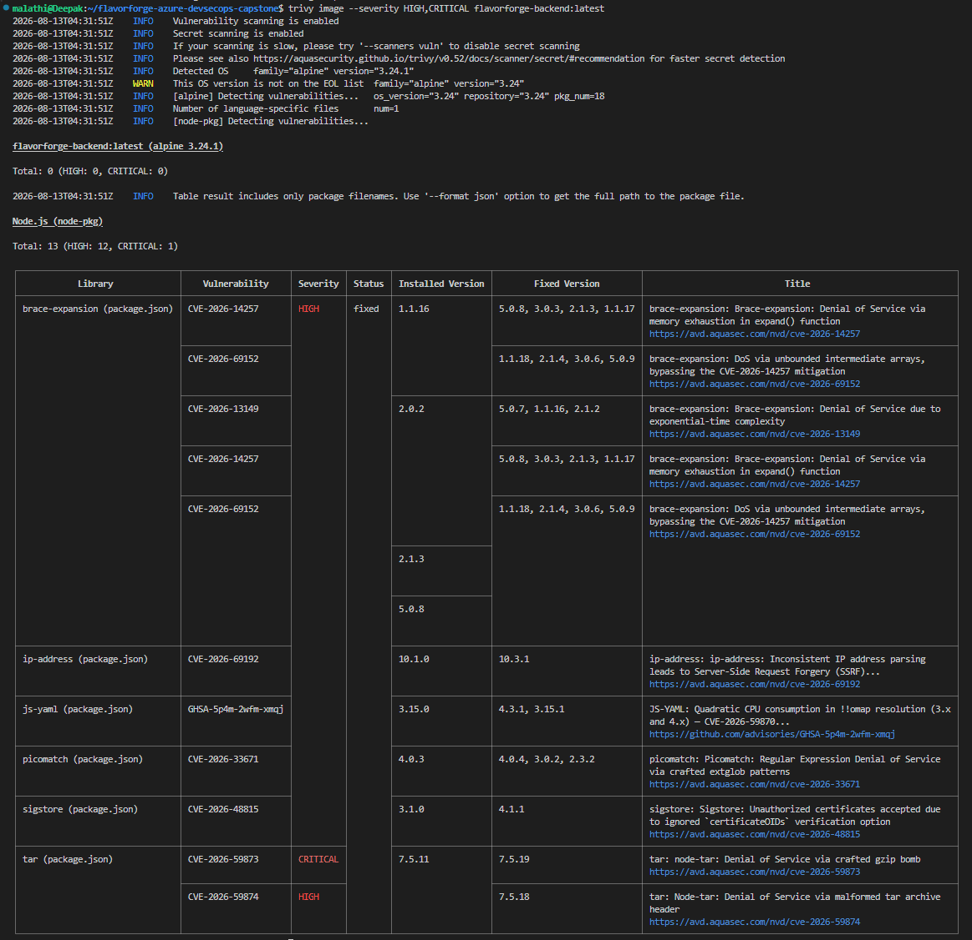
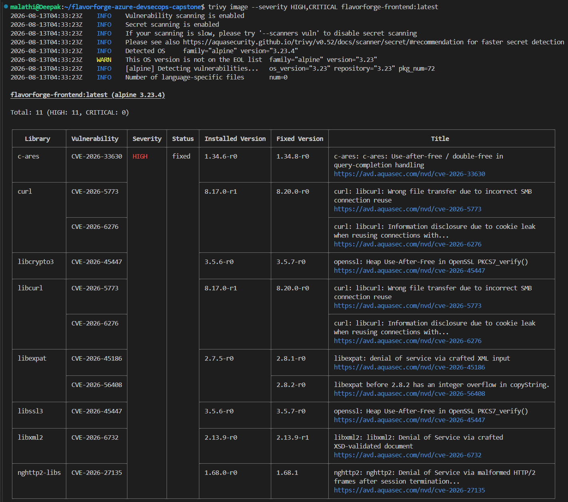
13. Trivy — Security Scanning
SECURITY
What question does Trivy answer?
What I scanned
“Do the filesystem or container images contain known vulnerabilities that should be identified before deployment?”
Filesystem plus frontend and backend container images. Reports were saved under reports/trivy/.
trivy fs .
trivy image <frontend-image>
trivy image <backend-image>
SCREENSHOT TO SHOW
screenshots/build-journey/trivy/backend-report.png
SCREENSHOT TO SHOW
screenshots/build-journey/trivy/frontend-report.png
Show: backend image report
Show: frontend image report
FlavorForge Azure DevSecOps Capstone • 14
Notes:
Trivy adds security scanning to the delivery process. I used it to scan the filesystem and the frontend and backend container images. The project stores the resulting reports under reports/trivy. A simple way to remember the difference is: SonarCloud focuses on source-code quality, while Trivy checks the filesystem and container images against known vulnerability information. In the presentation I will show one backend report and one frontend report.

Slide 15
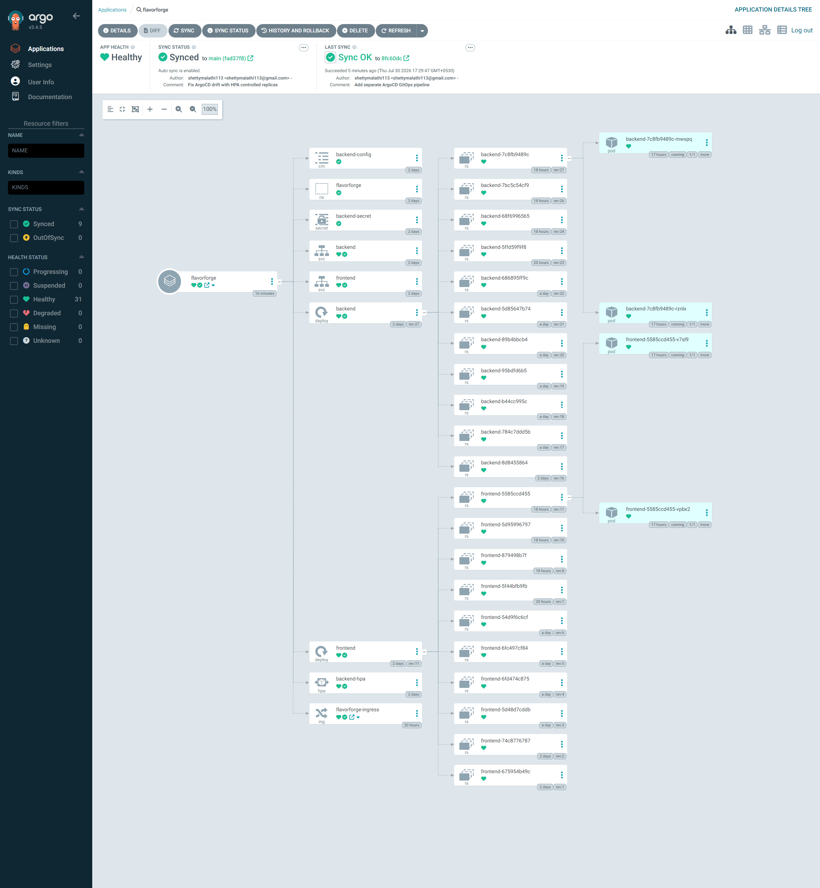
14. Argo CD — GitOps
DELIVERY
Desired state
Argo CD
Reconciliation
Kubernetes manifests are stored in Git. Git becomes the source of truth for the declared application state.
Argo CD watches the Git-defined desired state and compares it with the live Kubernetes state.
When the desired state and live state differ, Argo CD can synchronize the application according to the configured GitOps workflow.
Git
Argo CD
AKS
Running App
kubectl get applications -n argocd
kubectl get application flavorforge -n argocd \
-o jsonpath='{.status.sync.status} | {.status.health.status}'
SCREENSHOT TO SHOW
screenshots/argo-cd/4-flavorforge-application-details-tree-argo-cd.png
Show: FlavorForge Argo CD application tree
FlavorForge Azure DevSecOps Capstone • 15
Notes:
Argo CD is where I introduced GitOps. The Kubernetes configuration in Git represents the desired state. Argo CD continuously compares that desired state with the live cluster and reconciles the application. This is different from simply running kubectl manually every time. In my verification I used kubectl get applications and checked the FlavorForge Application status. One important accuracy point for the presentation: my latest Git commit is 12d34d1, while the verification output I captured earlier showed Argo CD synced to 4f53097. I should only say it is synchronized to 12d34d1 if I refresh/synchronize and verify that tomorrow.

Slide 16
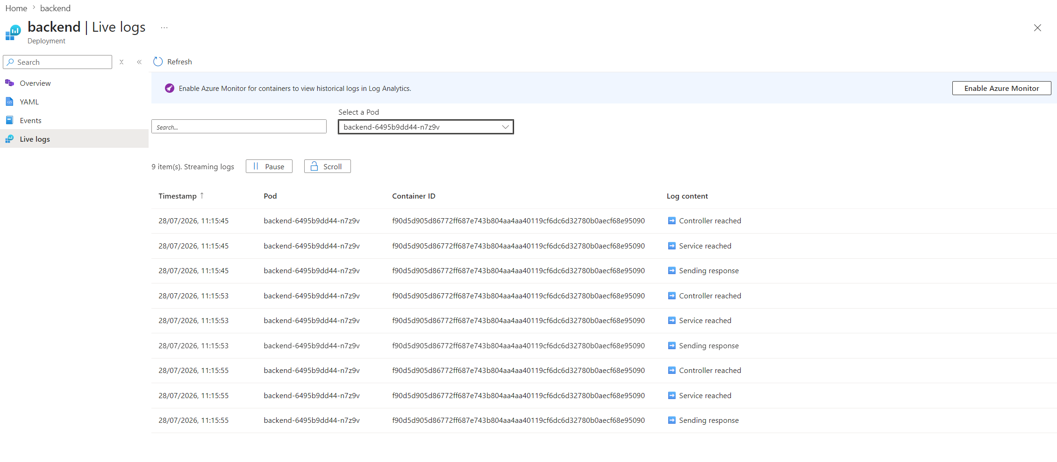
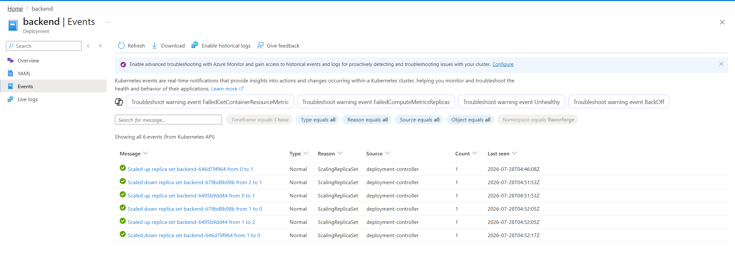
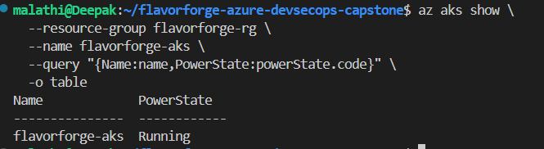
15. Azure Monitor / Observability
OPERATIONS
Why monitoring?
Signals I verify
Operational goal
Deployment is not the end. I need visibility into health, logs, events and resource behavior after the application is running.
Health endpoint
Pod/service state
Application logs
Kubernetes events
Resource metrics / monitoring
Detect problems, understand what happened and verify that the deployed application remains usable.
SCREENSHOT TO SHOW
screenshots/azure/19-backend-live-logs.png
SCREENSHOT TO SHOW
screenshots/azure/20-backend-events.png
SCREENSHOT TO SHOW
screenshots/azure/27-aks-cluster-running.png
Show: backend live logs
Show: backend events
Show: AKS running
FlavorForge Azure DevSecOps Capstone • 16
Notes:
Monitoring closes the DevSecOps loop. After deployment I need to know whether the system remains healthy. My evidence includes application health, live backend logs, Kubernetes events and the running AKS cluster. Azure Monitor and the Kubernetes operational data provide visibility into what is happening. I will focus on the practical question: if the application fails, where would I look first? Health, Pods, Services, logs and events are the first places.

Slide 17
16. End-to-End Deployment Flow
INTEGRATION
GitHub
Azure DevOps
Build/Test
SonarCloud
Trivy
Docker
ACR
AKS
Argo CD
Monitor
1 — Code to Image
2 — Image to Cluster
3 — GitOps to Operations
Developer pushes code → pipeline validates it → Docker builds the frontend/backend images → images are published to ACR.
Kubernetes manifests describe the desired application → AKS runs Deployments and Pods → Services and Ingress expose the app.
Argo CD reconciles desired state → application becomes Synced/Healthy → logs, health and monitoring provide operational evidence.
Final verification examples:
kubectl get all -n flavorforge
kubectl get svc -n flavorforge
kubectl get applications -n argocd
FlavorForge Azure DevSecOps Capstone • 17
Notes:
This slide brings the individual technologies together. A code change starts in GitHub. Azure DevOps builds and validates it, SonarCloud checks quality, Trivy checks security, Docker creates images and ACR stores them. Kubernetes on AKS runs the application. Argo CD provides the GitOps deployment model and monitoring verifies the running system. This is the core story of my project: each tool solves a specific problem, and the tools form one delivery system.

Slide 18
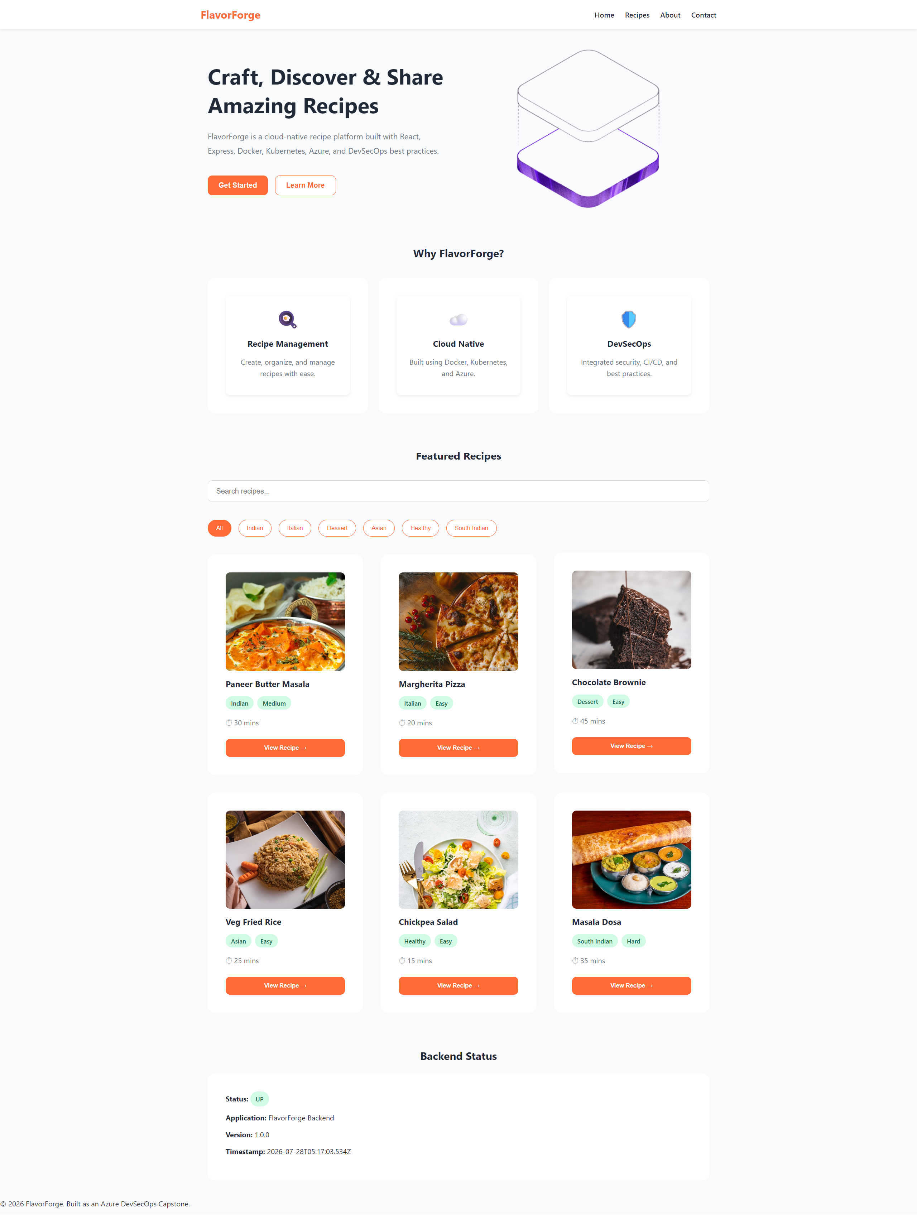
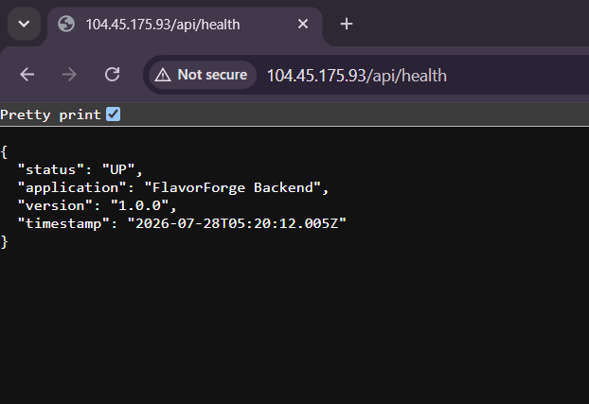
17. Verification — Application Running
VERIFICATION
Application
Backend
Platform
Frontend accessible and recipes functionality working.
Health endpoint and recipe API responding.
AKS workloads, services, ingress and GitOps state verified.
SCREENSHOT TO SHOW
screenshots/kubernetes/frontend-in-the-browser-http-104-45-175-93.png
SCREENSHOT TO SHOW
screenshots/kubernetes/backend-in-the-browser-http-104-45-175-93-api-health.png
SCREENSHOT TO SHOW
screenshots/argo-cd/argocd-applications.png
Show: Argo CD application
Show: deployed frontend
Show: deployed backend health
FlavorForge Azure DevSecOps Capstone • 18
Notes:
The final verification is not just that a pipeline is green. I verify the actual application. The frontend should load, the backend health endpoint should respond, Kubernetes workloads should be running, services should be available and Argo CD should report the expected application state. These checks connect the engineering work to a user-visible result.

Slide 19
18. Challenges & Troubleshooting
LESSONS
Git / synchronization
Docker / deployment
Kubernetes / GitOps
I had to keep GitHub, Azure DevOps and the GitOps state aligned and verify which commit each system was actually using.
Container image tags, registry paths and Kubernetes image references must match. A mismatch can make a deployment look correct while running an older image.
Troubleshooting requires checking Pods, Services, events, logs and Argo CD state rather than guessing.
• My project contains dedicated troubleshooting documentation for application, Docker, pipeline, security/quality, Kubernetes, Argo CD and Azure issues.
• The lesson: verify each layer independently before moving to the next layer.
FlavorForge Azure DevSecOps Capstone • 19
Notes:
The project was not a straight-line exercise. I encountered and documented issues across Git, Docker, pipelines, security tools, Kubernetes, Argo CD and Azure. One important lesson was to verify the state at each layer instead of guessing. For example, image tags must match between Docker, ACR and Kubernetes. GitOps also requires checking the actual commit that Argo CD has synchronized. My troubleshooting documentation is part of the project evidence because it shows how I diagnosed and corrected problems.

Slide 20
19. Final Outcome / What I Learned
CONCLUSION
Source
Automated CI
Security
Containers
Cloud
Kubernetes
GitOps
Operations
Technical outcome
DevSecOps outcome
My key learning
A full-stack application was transformed into a containerized, cloud-native deployment on Azure using AKS and Kubernetes.
Build, test, code-quality and security controls were integrated into the delivery workflow rather than treated as separate manual activities.
The biggest learning was understanding how the technologies work together and how to verify each layer when something fails.
Thank you
FlavorForge Azure DevSecOps Capstone • 20
Notes:
To conclude, the project demonstrates a complete journey from source code to a running cloud-native application. The important outcome is not just that FlavorForge runs. I implemented source control, containerization, Azure infrastructure, Kubernetes deployment, automated CI, code-quality and security controls, GitOps delivery and operational verification. My biggest learning was understanding how these technologies work together and how to troubleshoot each layer systematically. Thank you. I am happy to explain any implementation step in more detail.

